Slide 1
Dataiku Assessment
Abdul Moiz Amir

Slide 2
Census Income Analysis
Goal: Predict whether an individual earns more than $50K per year using U.S. Census data.
Use Case: Government policy, labor economics, tax planning, or targeted outreach.
Source: U.S. Census Bureau
94% < $50,000
6% > $50,000

Slide 3
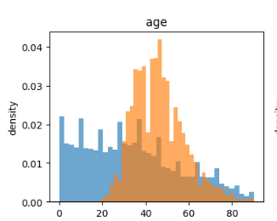
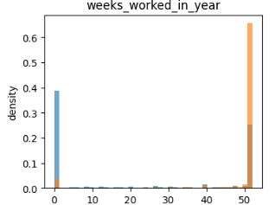
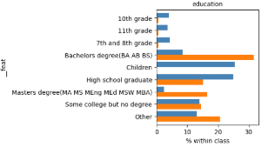
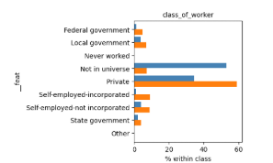
Some Drivers of Income > $50,000

Slide 4
Some Drivers of Income > $50,000
P(Income > 50k) = 0.06
P(Income > 50k | Invests) = 0.32 (chances increases by 500%)
P(Income > 50k | Masters) = 0.31 (chances increases by 500%)

Slide 5
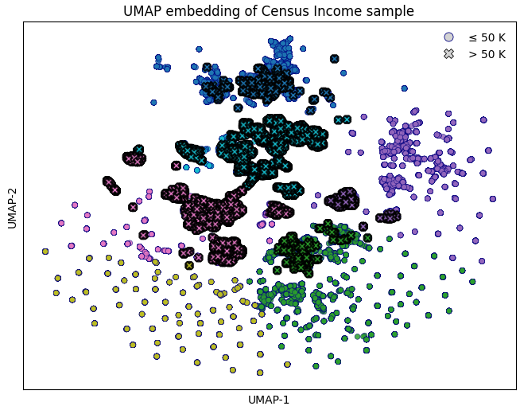
Demographic Cluster
Income > $50,000:
white males with veteran benefits working in Private sector as a professional specialty
Income <= $50,000:
Age groups not in the work force
Uneducated females

Slide 6
AI Classification Engine
Data Ingestion
Feature Engineering
(Skipped due to time
constraints)
Modeling
Evaluation
Deployment

Slide 7
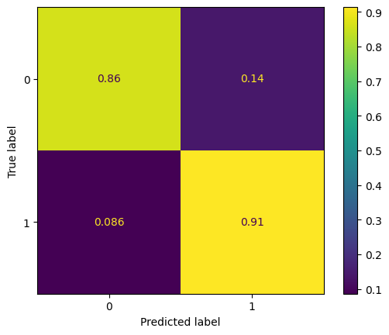
Modelling Efforts - Validation
Data Split
Learn.csv: 75% train, 25% validation
Models Considered
Logistic Regression (as baseline): ROC-AUC 0.94
LightGBM: ROC-AUC 0.955
NaiveBayes (not implemented due to time constraints)
Optimal Threshold from validation: 0.059
F1: 0.47

Slide 8
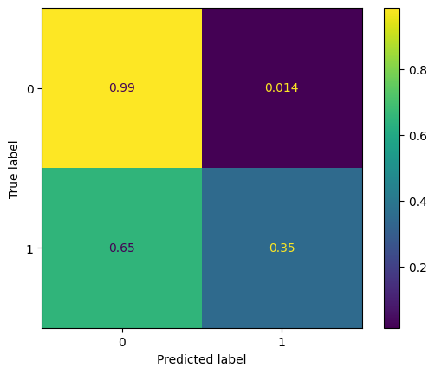
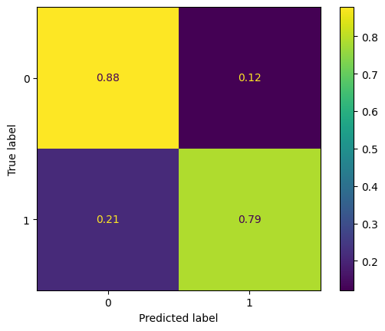
Modelling Efforts – Challenges
Using Threshold from Validation Set
F1: 0.45
Using Threshold from Tuned on Test Set
F1: 0.43

Slide 9
Thank You!

